Slide 1
Deep Learning
ANN/CNN/RNN

Slide 2
Why Deep Learning?
Two key reasons why researchers and experts tend to prefer Deep Learning over Machine Learning:
Decision Boundary: Machine Learning algorithm learns the mapping from an input to output, need lots of data to train these models. In the case of classification problems, the algorithm learns the function that separates 2 classes – this is known as a Decision boundary. It cannot learn decision boundaries for nonlinear data .
Feature Engineering: Extracting features manually from an image needs strong knowledge of the subject as well as the domain. It is an extremely time-consuming process. Thanks to Deep Learning, we can automate the process of Feature Engineering!

Slide 3
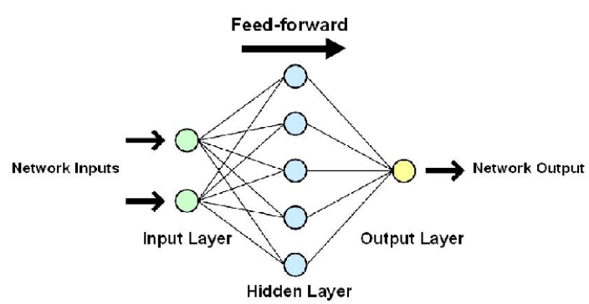
ANN
ANN (MLP)is a Feed-Forward Neural network because inputs are processed only in the forward direction.
ANN can be used to solve problems related to:Tabular,Image &Text data.
Activation functions helps the network learn any complex relationship between input and output.
While solving an image classification problem using ANN, the first step is to convert a 2-dimensional image into a 1-dimensional vector prior to training the model because of that the number of trainable parameters increases drastically with an increase in the size of the image.
ANN loses the spatial features of an image. Spatial features refer to the arrangement of the pixels in an image.
ANN cannot capture sequential information in the input data which is required for dealing with sequence data

Slide 4
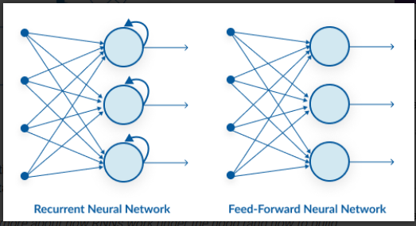
RNN vs ANN
A looping constraint on the hidden layer of ANN turns to RNN.
RNN(recurrent neural networks) solve the problems related to: Time Series data, text data & Audio data.
RNN captures the sequential information present in the input data i.e. dependency between the words in the text while making predictions.
Deep RNNs (RNNs with a large number of time steps) also suffer from the vanishing and exploding gradient problem.
gradient computed at the last time step vanishes as it reaches the initial time step.

Slide 5
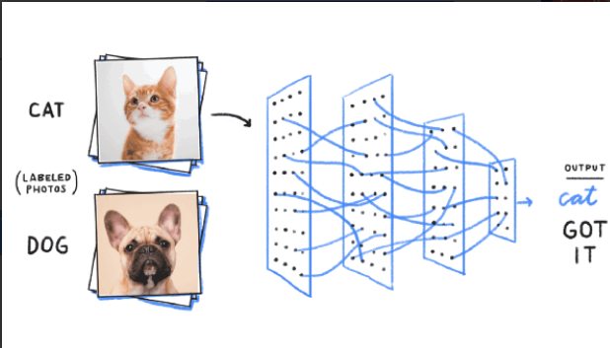
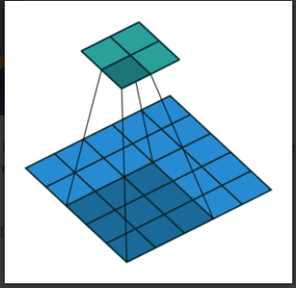
CNN
Especially prevalent in image and video processing projects.
CNN learns the filters automatically without mentioning it explicitly. These filters help in extracting the right and relevant features from the input data
It captures the spatial features from an image. Spatial features refer to the arrangement of pixels and the relationship between them in an image. They help us in identifying the object accurately, the location of an object, as well as its relation with other objects in an image

